Slide 1
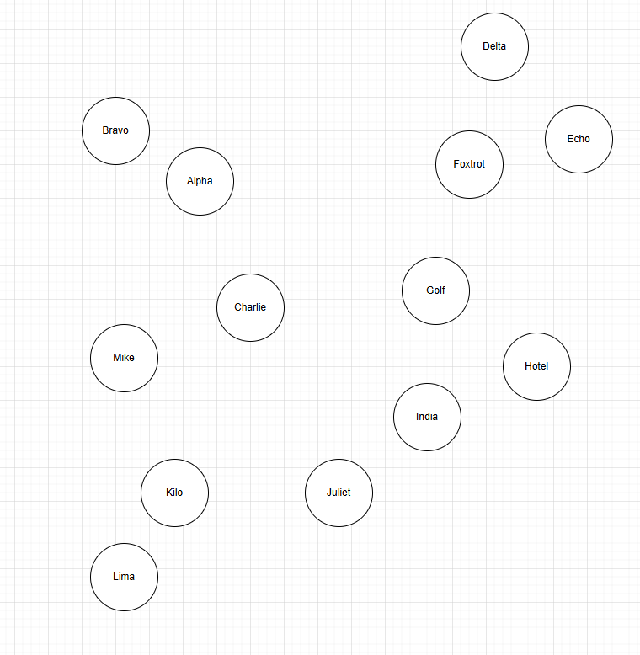
1.018
0.950
0.822
1.147
2.587
2.948
2.685
1.118

